Slide 1
Using Soft Markers in Attack Attribution
Char Sample

Slide 2
Introduction
Who am I and why am I looking at this problem?
  Char Sample – student & security professional
  Why do we care about attack attribution?
Acknowledgments
  David Barnett, Paul Murray, George Jones, Dr. Dominic Guss, and Diana Kelley.

Slide 3
Introduction
Explanation of the problem
  We simply don’t really know the source of many attacks, we guess.
  Some attackers boast and tell us… at least what they want us to know or think.
  There appears to be a war going on, can we get a little creative?
  Recognize this as a supplement not a replacement.

Slide 4
Attribution Background
A little history.
Tracing back in the day was pretty easy, then came firewalls.
  NATs
  Proxies
  Anonymizers etc.
  Tunnels
A trace today almost never shows all of the hops.
Tracking software gets inserted, discovered, then turned off.

Slide 5
Current Solutions Limitations
Relies on cooperation.
Focuses exclusively on technical aspects.
Dynamic environment (fast flux sites) is more challenging.
Generally speaking we are spending a lot of resources for incremental improvements.
In part, our problems are grey (or fuzzy) but our technology solutions are binary (b/w).

Slide 6
Different Perspective?
When you find your self in a hole, stop digging. (no pun intended)
What other areas of science can help us?
  Can we get an assist from the soft sciences?
    Criminals are profiled in other crimes
    Can we profile Computer Network Attack (CNA) behaviors?
      If we can, to what degree?
      What aspects?
Notes:
NetSA in DDM…. Slides in Flocon

Slide 7
The Role of Culture
Profiling CNA behaviors:
  Not the individual.
  Groups would be good but we lack foundational information.
    Countries can provide foundational information.
    Beyond language
      We see the differences in art, sport, etc.
      Customs also but, suspect this is not as vital and out of scope.

Slide 8
The Role of Culture
“Culture is defined as the collective mental programming of the human mind which distinguishes one group of people from another.” (geert-hofstede.com/countries.html)
  Does not reflect differences between individuals.
  Statements about cultures are general and relative.
  The appeal of culture lies in the fact that the people’s thought processes subconsciously reflect their cultural background.
    While not great for individual hacker attribution it has cyberwar implications: defensive and offensive.
    Markers should reveal themselves even with re-used attacks.
Notes:
Relative to each other, so masculinity does not imply a country w/ a low score lacks “manly men”

Slide 9
What are Soft Markers?
Hofstede identified 4 cultural dimensions:
  Power distance
  Individual vs Collective
  Masculine vs feminine
  Uncertainty avoidance
Others have added to the model
  Long Term Orientation vs Immediate (Bond)
  Indulgence vs restraint (Minkov)
  Monumentalism vs self-effacement (Minkov)

Slide 10
Cultural Dimensions & Attacks
What do each of these mean to attack patterns?
  Power distance
    Secondary characteristic, more on this later with Guss
  Individualism vs collectivism
    Would expect to see big steps vs incremental steps
  LTO vs STO
    Bots, duqu vs DoS
  Masculine vs Feminine
    Aggressive behaviors
  Uncertainty avoidance
    This may manifest in behaviors not software.
  Indulgence vs Restraint
    Instant gratification (DoS) vs restraint (duqu)
  Monumentalism vs self effacement
    “Monuments” in code or on servers, bragging, taunting, leaving behind special objects.
    Lack of “monuments” can also serve as a clue.
Notes:
Very nature of network attacks is an aggressive behavior, so this may need to be a secondary trait.

Slide 11
Cultural Dimensions & Attacks
Issues, concerns, caveats, etc.
  “The study of culture and decision making is a relatively new and unexplored field (Guss, 2004).”
    Culture and decision making is a component of this study.
    Overall age of cross-cultural study is relatively young, even Hofstede’s work is young in research terms.
  Must guard against stereotypes.
  Network attack activity is inherently an aggressive behavior, disproportional representation by certain countries like US.
  Even the obvious, must be supported.
  Something borrowed.
    Role of re-usable code,
    Automated tools etc.
  Not every area may relevant, will need to separate primary and secondary traits for comparisons.

Slide 12
Cultural Dimensions - Guss
Dr. Dominic Guss
  Examines specific markers
    Individualism vs collectivism
    Discovered that individual vs collectivist values “can influence the perception of the problem, the generation of strategies and alternatives, and the selection of one alternative (2004)”.
  How does this relate to computer and network attacks?
    Dr. Guss gathered inputs for his profiles from Dr. Hofstede
    High degree of individualism correlates to faster decision making while collectivism correlates to proceeding slowly and carefully.
  Focuses much of his work in theses two areas:
    Complex problem solving (CPS)
      Parsing through the CPS results to determine application to CNA behaviors.
    Dynamic decision making (DDM)
Notes:
Do you attack directly… going through the front door or are you more subtle.

Slide 13
Cultural Dimensions - Guss
Dr. Dominic Guss (continued)
  Individualism vs Collectivism
    In individualist cultures people are confident in their decision making ability.
    Collectivist cultures the lack of trust in decision making ability results in higher hypervigilance, avoidance, and buck passing.
  Integrated several of Hofstede’s areas together such as LTO and Power distance.
  What he expected:
    Collective, high power distance with high long term orientation – should do well w/ CPS.
  What he actually found:
    Individualism correlated with risky and expansive strategies.
      Do things different.
    Collectivism correlated with incremental and defensive strategies.
      Do things better.
    Power distance values intensifies or weakens strategies resulting from individual or collectivist values orientation.

Slide 14
Cultural Dimensions Value
How does this translate to CNA?
  A few “Art of War” quotes:
    “Know the enemy and know yourself; in a hundred battles you will never be in peril.”
    "Thus those skilled in war subdue the enemy's army without battle. ... They conquer by strategy.”
  Suggests that by understanding cross cultural thought processes we may have an additional data point in attack attribution to add to the other data points currently in use.
    New attacks can be viewed through traditional methods, then mapped to cultural markers in order to gain further insight to our adversaries.
    We may also be able to determine adversary’s specific weaknesses for exploitation.
    The ability to classify attacks by adversary methods offers hope for predictive analysis.

Slide 15
Research Project
Create a taxonomy of attacks mapped to work by: Hofestede, Minkov, and Guss.
Quantify results.
  Look for patterns.
Create the foundation for further work in this area.
  Cloaking
  Assisting in APT detection and attribution.
  Creating better attacks, customized for adversary.

Slide 16
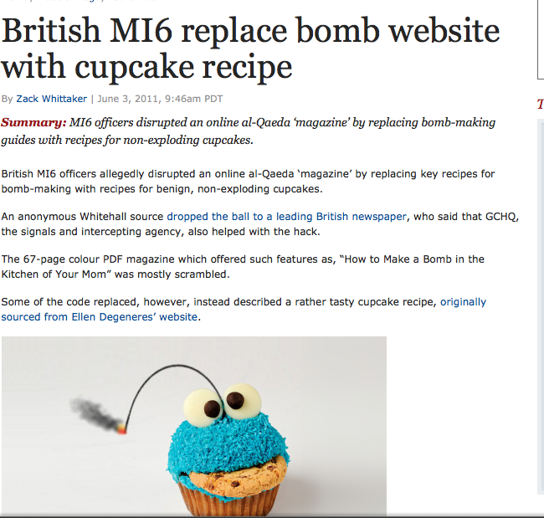
Example #1

Slide 17
Example #1
Example: How to bake cupcakes example
  So there is not a British cheekiness value but …
    UK scores high on individualism and low on power distance.
      Have a clever idea? Take the ball and run with it.
    Still researching the indulgence vs self-restraint UK scores not available at this time.
    Low on Long Term Orientation
      This may hint at why the web site was defaced instead of “tapped”.

Slide 18
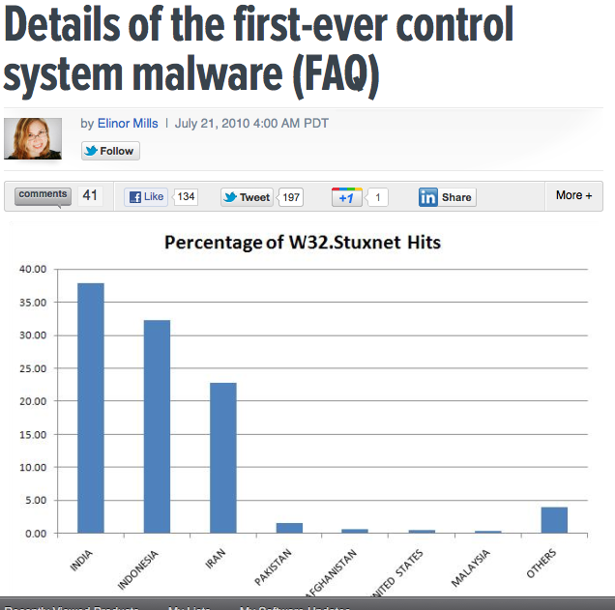
Example #2

Slide 19
Example #2 Explanation
Targeted specific industrial control systems running Windows
  Four zero day attacks
    Creativity
    Funding
  Targeted specific PLCs used to control uranium enrichment by altering the centrifuge speed.

Slide 20
Example #2
Example: Stuxnet
  Joint effort US, and Israel.
    US is high on Individualism, Israel is medium.
      Medium score by Israel is important because they will both do differently and do better.
      The uniqueness or newness doing it differently US
      “Israel can pull talent together from across its industry and military to create a team that can focus on a problem until it is solved.”
    Israel has a very low Power Distance score, US low/medium.
      Implies that Israel will execute faster or before US.
    Monumentalism vs self-effacing
      US ranked in the middle, no scores available for Israel.
      Ongoing debate on this point “Myrtus” or “MyRTUs”?

Slide 21
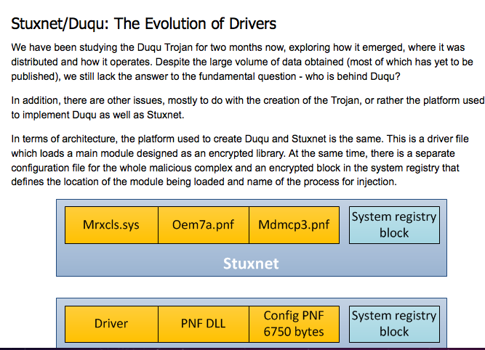
Example #3

Slide 22
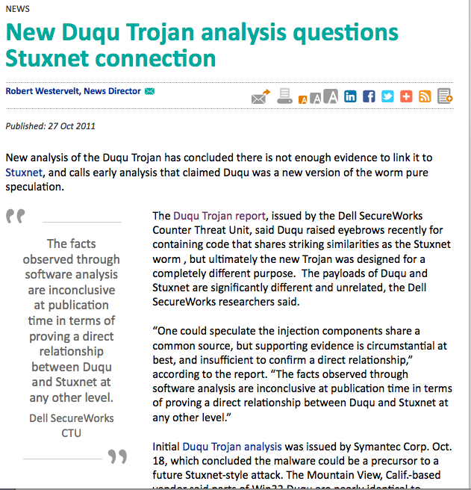
Example #3

Slide 23
Example #3
Example: Duqu
  First item that we notice is still no attribution.
  A couple of items of interest:
    Code re-use from Stuxnet
      Doing something better points to collectivist behavior.
    Duqu extensions
    Nature of the attack – “quiet ex-filtration of info”
  Duqu extensions, uniformity, collectivism
  Exfiltration without calling attention to self hints at self-effacing behavior, or at least a desire to not be seen.

Slide 24
What’s Next
Next steps
  Collect known attributed attack information.
  Create taxonomy.
    Define grouping by mapping general attack behaviors to cultural dimensions.
      Example: Were there “monuments” left in the code?
      Is this a novel attack, an improvement on an existing attack, or a creative re-use of existing attacks.
    Organize attacks into groupings and determine ranking/scoring scale.
    Quantify results, look for clusters.

Slide 25
What’s Next
Why should we care?
  Attack attribution is much more than simple strike back capabilities.
  Give counter attackers greater certainty.
  Potential to better anticipate attackers motivations and next move.
  Provides context for much of our current data.
  I am not alone:
    2009 Yu & Yang “An Analysis of the Impact Chinese and Western Cultural Values Have on Technological Innovation” Wuhan University of Technology

Slide 26
What I Need
More data … of course!
  Attributed attack reports are always helpful.
  More results on cross-cultural cognitive differences.
  Any help or support you can give me.
    Contact:
    charsample50@gmail.com

Slide 27
Closing
Questions
Comments

